Slide 1
Optimizing Apache Spark
Optimizing with AQE & DPP Dynamic Partition Pruning

Slide 2
New Strategies for Spark 3.x
Dynamic Partition Pruning
Consider a 100GB table of transactions and a 30MB table of cities
Without any filtering, this is a massive shuffle operation
A 1-minute query on transactions can easily become an hour long join with the subsequent shuffle
Filtering the cities table by country (e.g. USA only) means we are now joining a 100GB table to a 15MB table
This is still a massive shuffle operation!

Slide 3
New Strategies for Spark 3.x
Both of these solutions can work but only to a very limited degree
DPP - What Can We Do?
We can broadcast the cities table:
At 10+ MB, it’s still too big for auto-broadcasting
We would have to force a broadcast with a hint
This wouldn’t be an option if our “big” table was 1 TB and our “small” table was 100 GB
We can create our own subquery
Explicitly select all the US city ids and collect() them as the array city_ids
Filter both the transactions and cities table with $”city_id”.isin(city_ids)
Join the ~70GB transactions table to the ~15MB cities table
But it may not be reasonable to expect the consumers of your data to do this

Slide 4
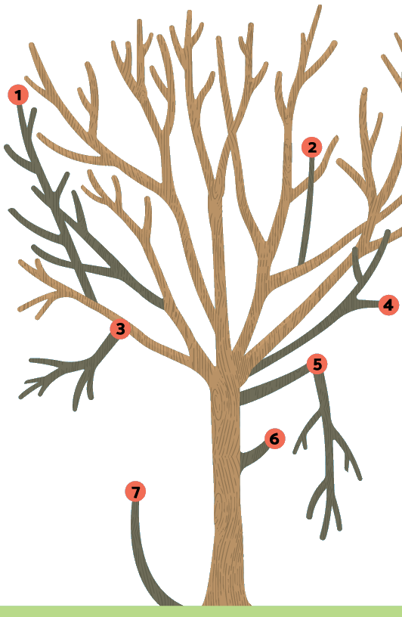
New Strategies for Spark 3.x
What Does DPP Actually Do?
Dynamic Partition Pruning uses a combination of those strategies
Spark will produce a query on the “small” table
The result of which is used to produce a “dynamic filter” similar to our list of city_ids
The “dynamic filter” is then broadcast to each executor
At runtime, Spark’s physical plan is adjusted so that our “large” table is reduced with the “dynamic filter”
And if possible, that filter will employ a predicate pushdown so as to avoid an InMemoryTableScan

Slide 5
New Strategies for Spark 3.x
Dynamic Partition Pruning, In Action
See Experiment #3799B, Step C (standard)
Note that DPP is enabled by default in Spark 3.0 (no contrast this time)
Recalling how a “standard” Scan / Filter / SortMergeJoin works
Identify the difference in this Query Plan compared to other queries we have seen

Slide 6
New Strategies for Spark 3.x
Dynamic Partition Pruning, Review
The “left” of the join is the transactions table & the “right” is the cities table
The “left” starts by scanning the cities table
The results of the cities scan is fed into the Subquery
The subsequent Scan parquet employes its predicate push down to...
...read 27 of 100 files
...read in only 7.5GB of the full 100GB
…read in only 2M of the 2B records
The “right” is processed and ultimately fed into a SortMergeJoin
Further proof is in the Physical Plan - see the DataFilter & PushedFilter

